Slide 1
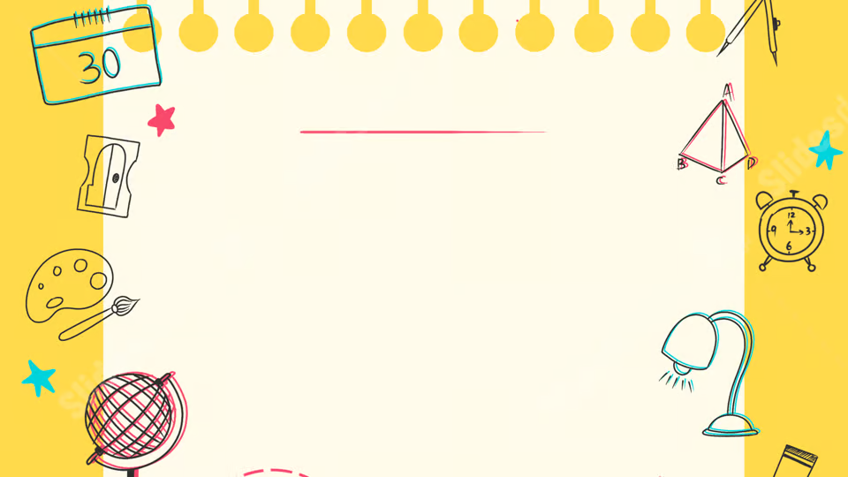
Types of AI
By Kit Horwood
(Week 2)

Slide 2
Learning Intentions:
This week you will learn:
What supervised/unsupervised learning is
How reinforcement learning works

Slide 3
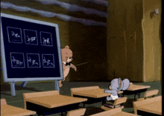
What is AI ‘training’?
Before they are used, AI models must first be trained
Training tells an AI what to output
Multiple types

Slide 4
Three major types:
Supervised learning
Unsupervised learning
Reinforcement learning

Slide 5
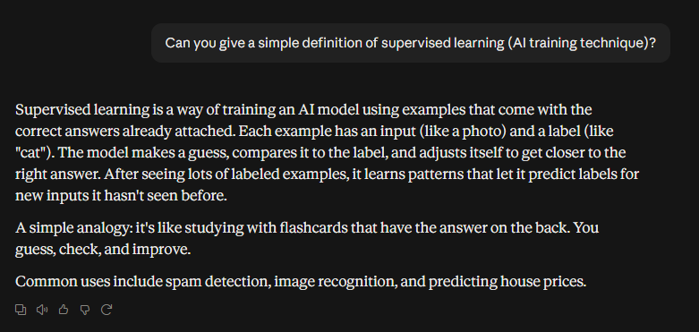

Supervised learning:

Slide 6
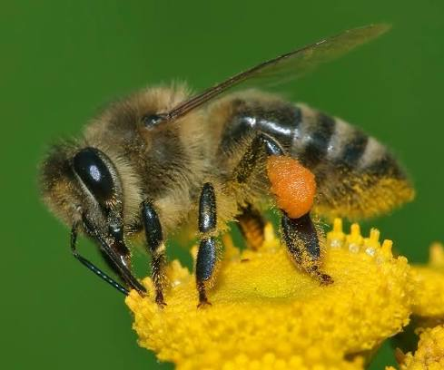
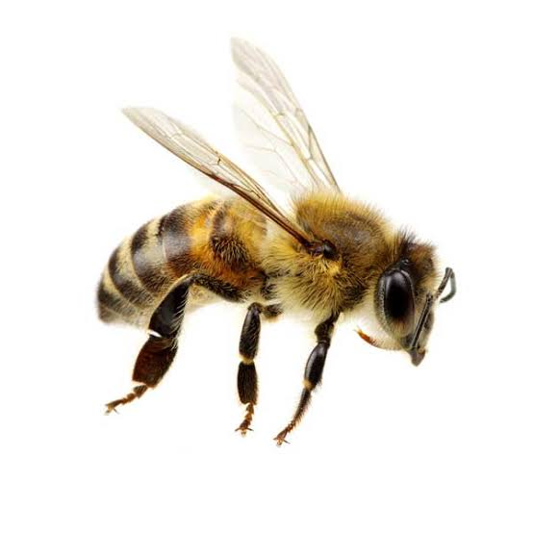
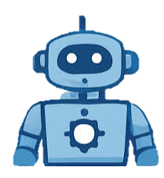
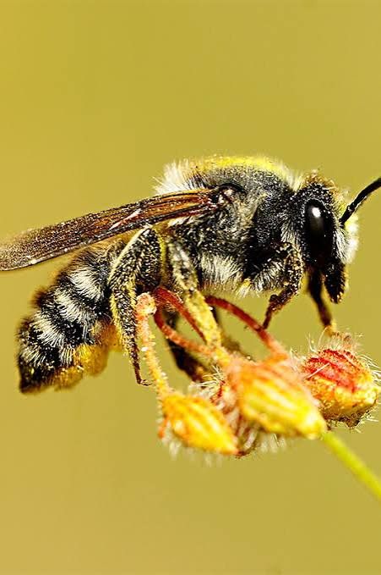
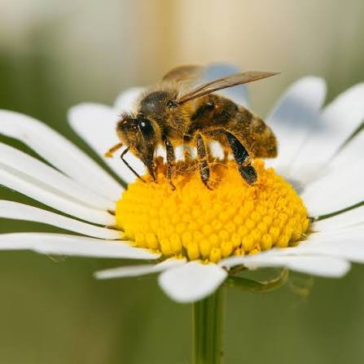

Example:
Yellow and black…
It’s a bee!
“These are all bees”
We give the AI pictures of bees
The AI finds patterns
The AI can then identify bees

Slide 7
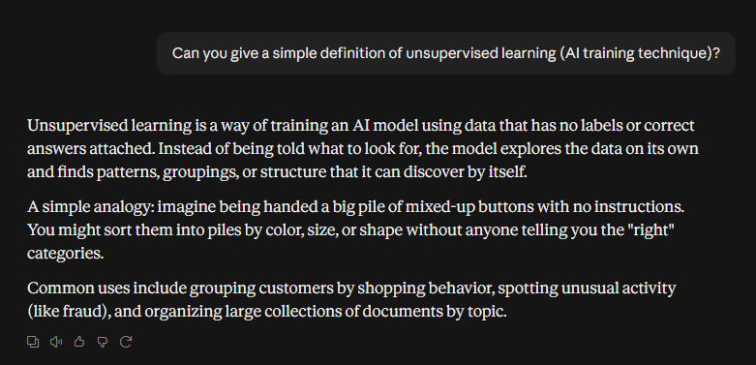
Unsupervised Learning:

Slide 8
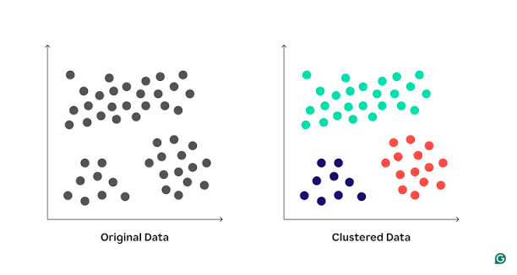
Example:
?
Unknown data:

Slide 9
The difference?
The two are similar
The main difference is that supervised learning gives the output information as well
Not just used with images

Slide 10
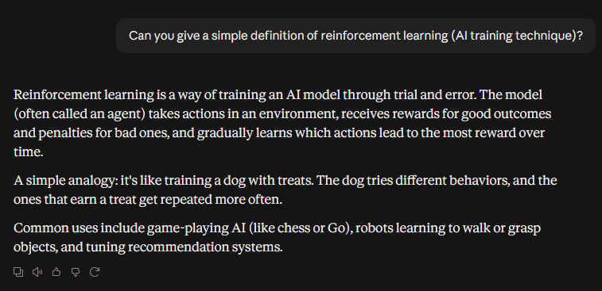
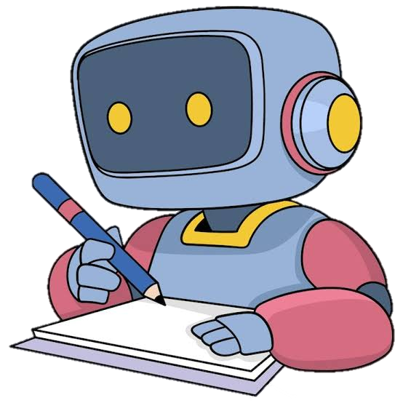
Reinforcement Learning:

Slide 11
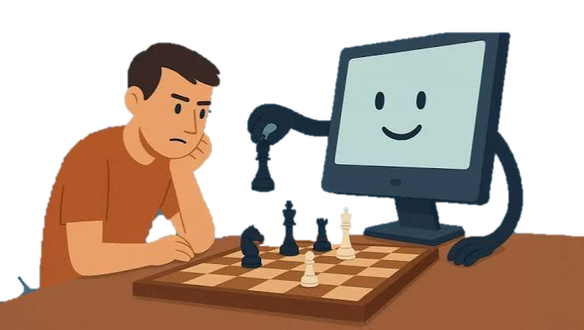
Example:
Google made a reinforcement learning AI called AlphaZero that played chess against itself
The AI made strategy improvements based on previous games
It quickly became better than any human

Slide 12
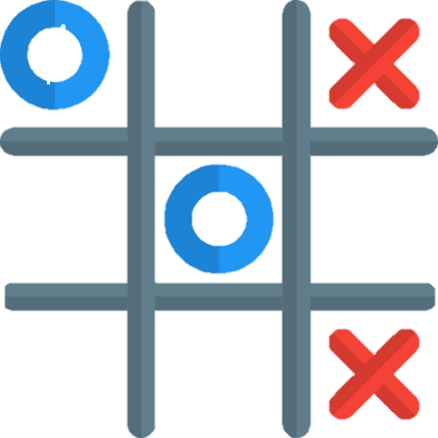
Try it yourself!
I have made a Tic-Tac-Toe reinforcement-learning algorithm.
The AI will start off terrible but get better and better as it plays games against you

Slide 13

Who can get the highest score?

Slide 14

Summary
Supervised learning works by feeding an AI with data and the correct answer
Unsupervised learning just provides the data
Reinforcement learning just provides the answer

Slide 15
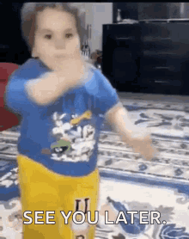
See you next week!

